Slide 1
Data Bases and Data Types
DL Day 3 class

Slide 2
Learning Objectives
By the end of this lesson, you will be able to:
Define the concept of a database and how it is used to store data:
Understand the fundamental concept of a database as an organized data storage system.
Identify the core components of a relational database table:
Recognize the key elements that make up a relational database table.
Explain basic database terminology like rows, columns, tables, and relationships:
Familiarize yourself with essential database terminology, including rows, columns, tables, and relationships.
Define data types:
Understand the concept of data types and their role in defining the kind of data that can be stored in a database.
Notes:
[Speaker Notes]
Begin by introducing the slide's main topic: the lesson objectives.
Highlight that by the end of the lesson, learners will have a solid understanding of various foundational concepts related to databases.
Provide brief explanations for each objective, emphasizing what learners will achieve:
Understanding what a database is and its purpose in data storage.
Recognizing the components of a relational database table.
Becoming familiar with core database terminology such as rows, columns, tables, and relationships.
Grasping the concept of data types and their significance in database design and management.
Conclude by encouraging learners to actively engage with the lesson to achieve these objectives successfully.

Slide 3
Learning Objectives
Database Skills for Analysts:
Enable analysts to:
Retrieve, combine, and prepare data for analytical projects, extracting valuable insights.
Identify connections between datasets to enrich analysis.
Empower self-service analytics.
Strong Database Familiarity:
Allows analysts to gather, investigate, and prepare data with flexibility and precision.
Notes:
[Speaker Notes]
Begin by introducing the slide's main topic: the significance of database skills for analysts in the context of analytics.
Explain that having strong database skills empowers analysts to perform critical tasks.
Elaborate on these tasks:
Retrieving, combining, and preparing data for analytical projects, which ultimately helps in drawing out valuable insights.
Identifying connections between datasets, enriching the analysis with contextual information.
Facilitating self-service analytics, where analysts can independently explore and analyze data.
Emphasize that database familiarity provides analysts with the flexibility and precision required to gather, investigate, and prepare data effectively.
Conclude by underlining how these skills are fundamental for analysts to deliver data-driven insights and make informed decisions.

Slide 4
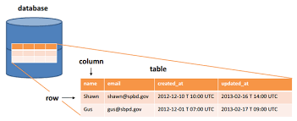
Databases
Database Definition:
A database is an organized collection of data stored and accessed electronically from a computer system.
Database Benefits:
Databases allow users to easily store, update, retrieve, and manage large amounts of information.
Data is structured and organized for efficient use.
Notes:
[Speaker Notes]
Begin by introducing the slide's main topic: an introduction to databases.
Explain that a database is essentially a structured and electronic repository of data.
Emphasize that databases offer several benefits, such as the ability to store, update, retrieve, and manage vast amounts of information efficiently.
Mention that data is organized within databases, making it easier for users to work with and extract meaningful insights.
Conclude by highlighting the importance of databases in various applications, from business operations to scientific research, where structured and accessible data is crucial for decision-making and analysis.

Slide 5
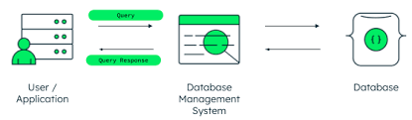
Databases
Database Management Systems (DBMS):DBMS is software used for various database operations.
It includes creating, accessing, managing, searching, and analyzing data.
Popular DBMS options include MySQL, Oracle, Microsoft SQL Server, and MongoDB.

Slide 6
Databases
Tables:
Databases organize information into tables.
Tables store data in rows and columns.
For instance, a "Customers" table might include columns like "Name," "Address," and "Phone Number," with each row representing an individual customer.
Records:
Also known as rows.
Each record is an individual entry stored in a table.
It collects related data across different fields.
Fields:
The columns in a database table are called fields or attributes.
Fields represent specific characteristics or attributes of the larger entries, such as a name or date.
Notes:
[Speaker Notes]
Begin by introducing the slide's main topic: the fundamental components of databases - tables, records, and fields.
Explain that tables are the containers that organize data, with rows and columns.
Provide a practical example with a "Customers" table to illustrate how columns (fields) like "Name," "Address," and "Phone Number" store information about individual customers (records).
Transition to the concept of records, emphasizing that they represent individual entries in a table, essentially the rows.
Highlight that records collect related data across the various fields, providing a complete set of information for a single entity, such as a customer or a product.
Discuss fields as the columns within tables, pointing out that each field represents a specific attribute or characteristic of the larger data entry.
Conclude by emphasizing that understanding tables, records, and fields is essential for effective data organization and retrieval in database systems.

Slide 7
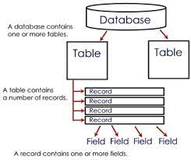
Databases

Slide 8
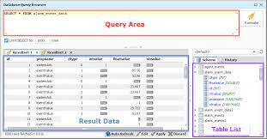
Databases
Queries: A database query is a request for specific information from a database. Allows for powerful analysis and filtering.
Notes:
[Speaker Notes]
Begin by introducing the slide's main topic: the significance of database queries.
Explain that a database query is essentially a request for specific data from within a database.
Emphasize that queries empower users to perform powerful analysis and filtering of data, enabling them to retrieve the exact information they need from a large dataset.
Provide real-world examples to illustrate the importance of queries, such as finding all customers who made a purchase in the last month or identifying the highest-selling products.
Conclude by highlighting how the ability to query a database efficiently is a critical aspect of leveraging data for informed decision-making and insights.

Slide 9
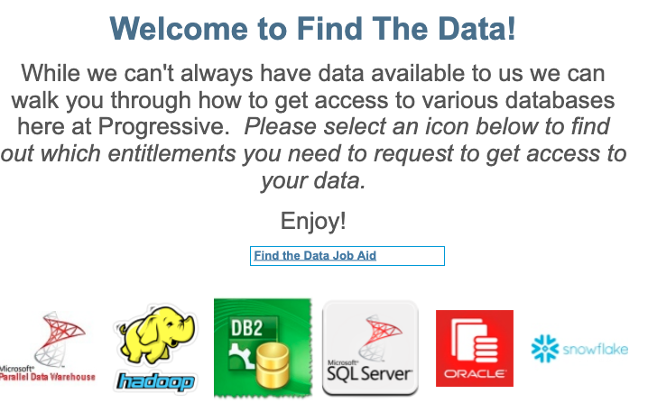
Databases
Databases At Progressive: Findthedata/
https://tableauserver/t/PersonalLines/views/FindTheData/Home?%3Aembed=y&%3AshowShareOptions=true&%3Adisplay_count=no&%3AshowVizHome=no#1

Slide 10
Relational Databases
Relational Databases: Organize structured data into tables for easy management, access, manipulation, and SQL-based linking.
Advantages:
Flexibility: Easily add new data categories, fields, and tables without altering existing structures.
Simplicity: Streamlined data organization for improved efficiency.
Performance: Efficient data retrieval and processing.
Notes:
[Speaker Notes]
Begin by introducing the slide's main topic: the benefits of relational databases.
Explain that relational databases provide a structured framework for managing data, with tables that are easy to work with using SQL.
Transition to the advantages of using relational databases.
Elaborate on flexibility, emphasizing how it allows for the seamless addition of new data elements and structures without disrupting existing data.
Discuss simplicity, highlighting how the structured format simplifies data organization, making it easier to manage and query.
Lastly, emphasize the performance benefits, explaining how relational databases enable efficient data retrieval and processing, making them a powerful tool for data-driven applications.
Conclude by reinforcing the idea that relational databases offer a robust and versatile solution for managing and utilizing structured data.

Slide 11
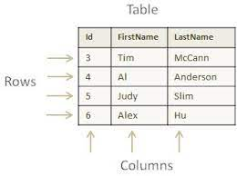
Relational Databases
Data Structure:
Structured, tabular data storage.
Utilizes two-dimensional database tables.
Tables mimic spreadsheets with cell-based layouts.
Data Representation:
Each row represents a unique record.
Columns define various fields or attributes for record types.
Notes:
[Speaker Notes]
Begin by introducing the slide's main topic: structured data storage in database tables.
Explain that this data structure is organized and tabular, with data stored in tables, similar to spreadsheet formats.
Mention that the use of two-dimensional tables with cell-based layouts makes it easy to visualize and work with the data.
Transition to the concept of data representation, highlighting that each row in the table represents a unique record, such as a customer or product, and columns define specific attributes or fields for those records.
Provide an example to illustrate this, like a "Customer" table with rows representing individual customers and columns representing attributes like "Name," "Address," and "Phone Number."
Conclude by emphasizing how this structured approach simplifies data storage and retrieval in database systems, enhancing efficiency and organization.

Slide 12
Relational Databases
Data Organization:
Tables organize data into fields and records.
Fields (columns) contain attributes (e.g., name, age) of a record.
Records (rows) represent individual data entries (e.g., customer, product).
Structured Relationships:
Tables are interconnected.
Structured relationships connect records across tables.
Notes:
[Speaker Notes]
Begin by introducing the slide's main topic: structured data organization in relational databases.
Explain that tables play a central role in organizing data, breaking it down into fields (columns) that define attributes and records (rows) representing individual data entries.
Give practical examples to illustrate the concept, such as a "Customer" table with "Name" and "Age" columns.
Transition to the concept of structured relationships, emphasizing that tables are interconnected, allowing data to be linked across different tables.
Mention that these structured relationships are essential for maintaining data integrity and enabling complex data queries and reporting.
Conclude by stressing how this organized approach enhances data management and retrieval in relational databases.

Slide 13
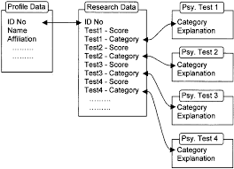
Relational Databases

Slide 14
Relational Databases
Key Constraints:
Define essential table relationships.
Ensure data accuracy and consistency.
Primary Key:
Uniquely identifies each record in a table.
Guarantees record uniqueness within the table.
Foreign Keys:
Establish links between records in different tables.
Create relationships between related data.
Notes:
[Speaker Notes]
Begin by introducing the slide's main topic: enforcing data integrity with key constraints.
Explain that key constraints define relationships between tables and play a vital role in maintaining data accuracy and consistency.
Dive into primary keys, emphasizing that they uniquely identify records within a table, eliminating any chance of duplication.
Discuss foreign keys, highlighting their role in linking records across different tables, enabling relationships between related data.
Emphasize that these constraints are crucial for maintaining the integrity of the database, ensuring data accuracy, and facilitating efficient data retrieval through well-defined relationships.

Slide 15
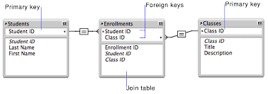
Relational Databases

Slide 16
Table Data Structures
Structured Format:
Database tables offer an organized, tabular structure.
Ensures efficient and consistent data storage.
Data Types:
Crucial aspect of table structure.
Define allowable data for each column.
Constraints ensure data adheres to predefined formats.
Notes:
[Speaker Notes]
Emphasize that structured data in tables provides a clear and organized way to store information.
Explain that data types help maintain data integrity by restricting the types of values that can be stored in each column.
Use examples to illustrate how data types work in practice, such as ensuring only numeric data in a "Price" column.
Mention that data types are essential for data validation and consistency in the database.

Slide 17
Table Data Structures
Data Types Overview:
Data types define the kind of data that can be stored in a database.
Examples of common data types:
TEXT: Allows letters, numbers, and special characters.
NUMBER or INTEGER: Requires numerical values.
DATE: Ensures properly formatted date values.
Data Type Enforcement:
Designating an AGE column to accept only integers enforces data consistency.
Each data type serves a specific purpose in database design and integrity.
Notes:
[Speaker Notes]
Begin by introducing the slide's main topic: understanding data types in databases.
Explain that data types are essential as they determine the type of data that can be stored in a particular column.
Provide examples of common data types to illustrate their diversity and application:
TEXT: Mention that it allows a wide range of characters, including letters, numbers, and special characters.
NUMBER or INTEGER: Emphasize that these data types are for numerical values.
DATE: Explain that it ensures date values are properly formatted and consistent.
Discuss the importance of data type enforcement for maintaining data consistency. For instance, when designating an AGE column to accept only integers, it ensures that the values are numbers, reinforcing data integrity.
Conclude by stressing that understanding and using appropriate data types are crucial for effective database design and data management.

Slide 18
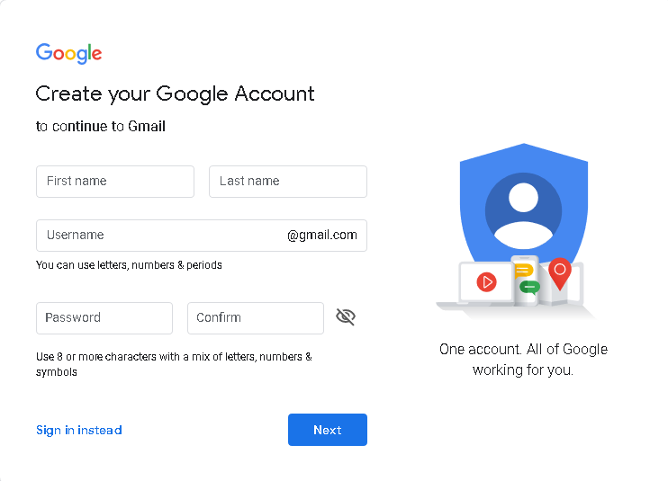
Table Data Structures
To understand SQL Server data types, let’s look at the following page to create a new Google account (for reference purpose only):

Slide 19
Table Data Structures
Input Requirements:
First Name and Last Name: Alphabets only.
Username: Letters, numbers, and periods.
Password: Alphabets, numbers, and special characters.
Data Storage:
Store user data in a Database Server.
Utilize various data types to match specific requirements.
Notes:
[Speaker Notes]
Begin by introducing the slide's main topic: input requirements and data types for storing user data.
Explain the input requirements for each of the fields:
First Name and Last Name should contain alphabets only.
Username can include letters, numbers, and periods.
Password can consist of alphabets, numbers, and special characters.
Emphasize the importance of adhering to these input requirements to ensure data integrity and consistency.
Discuss that user data is typically stored in a Database Server, highlighting its role as a central data repository.
Mention that in the database, various data types can be employed to accommodate different data requirements, such as using the TEXT data type for names, VARCHAR for usernames, and possibly encrypted data types for passwords.
Conclude by stressing the significance of selecting appropriate data types to match the specific needs of each data field, ensuring accurate and secure data storage.

Slide 20
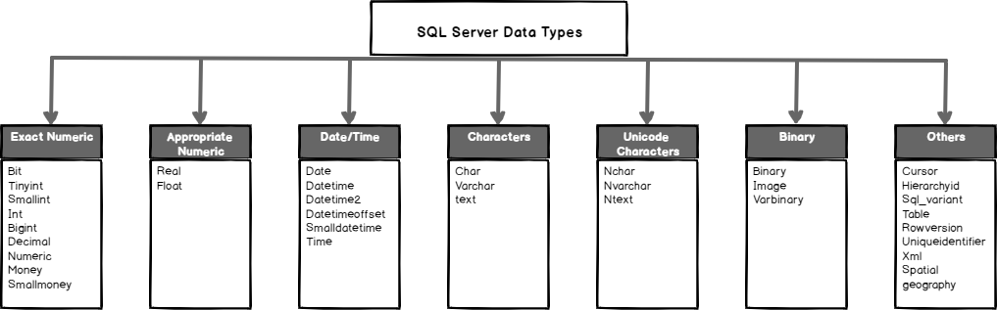
Table Data Structures
Categories of Databases Data Types

Slide 21
Table Data Structures
Exact Numeric:
Used for precise numeric values without rounding errors.
Approximate Numeric:
Suitable for numeric values where precision is not critical.
Date and Time:
Designed for storing date and time information.
Character Strings:
Used for storing text data, with varying lengths.
Unicode Character Strings:
Ideal for storing multilingual or special character text.

Slide 22
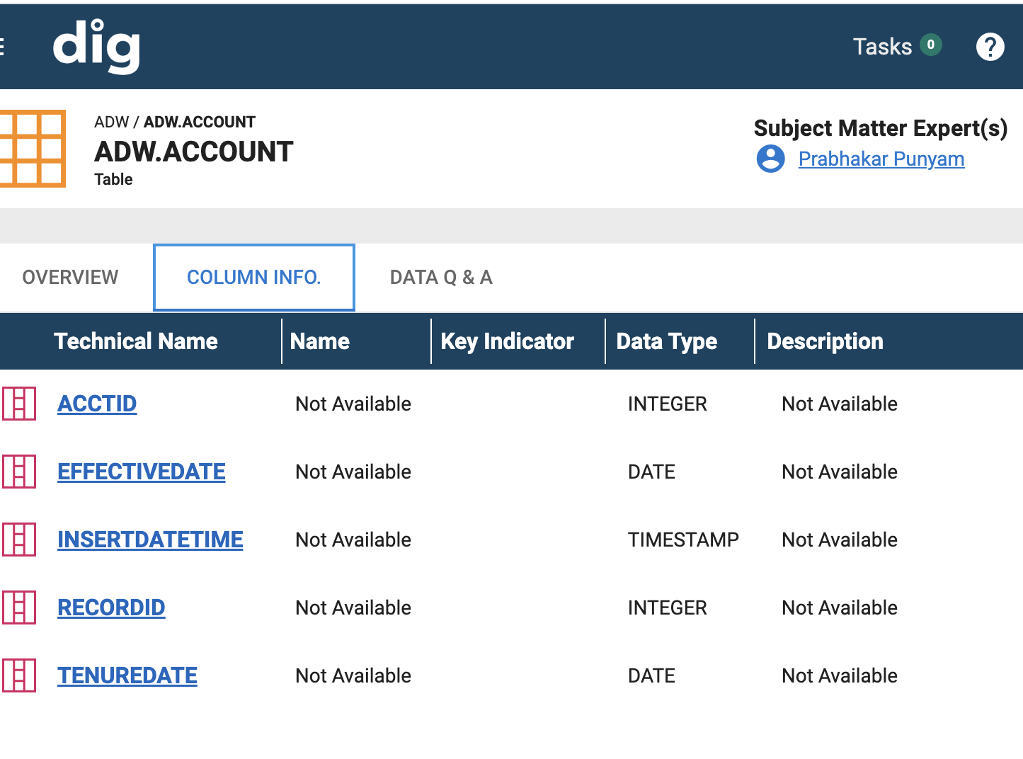
Table Data Structures
Using DIG to begin your data journey
Type DIG/ into your browser
take a look at some of the databases
Review the tables and columns
Identify the types

Slide 23
Query
A query is a request made to a database to retrieve specific data that meets certain criteria.
Some key points about database queries:
A query allows selective retrieval of data from a database rather than retrieving all records at once.
Queries are constructed using query languages like SQL with syntax specifying what data to retrieve and filter on.
The most common SQL queries are SELECT statements which define the table columns to show and the conditions rows must meet using WHERE clauses.

Slide 24
Query
Query criteria can filter on text matches, numeric & date ranges, associations between tables to derive relevant information.
Queries help answer specific business questions like "What products had the most sales last month?" without needing manual analysis.
Results can be sorted, aggregated (summaries), and segmented as needed for reporting or analysis.
Parameters can be used to make dynamic queries that change based on user inputs.

Slide 25
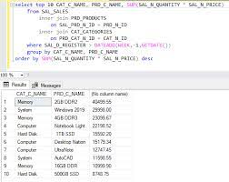
Query
In summary, database queries allow users to selectively retrieve the most relevant data for their needs from among large datasets in an efficient manner.
They underlie analytics, business intelligence and many database applications.

Slide 26
Summary
Key Points
Databases provide electronic storage and data management via optimized table structures and sophisticated database management systems for reliably scaling data.
Relational databases organize data into tables with formal connections between them to model real-world entities and relationships. This provides simplicity and performance.
Tables consisting of rows, columns and keys give a standardized structure combined with the flexibility to adapt for future needs through constraints, normalizations etc.
SQL queries allow selectively filtering and aggregating data to derive insights efficiently without manual effort even from billions of rows due to the deliberate underlying database designs.

Slide 27
Summary
From storing to accessing data, databases emphasize formalized tables and queries as specialized structures engineered for the era of data-driven decisions. This model balances optimal speed, scale and integrity demands allowing modern applications to leverage data systematically

Slide 28
Exercises
Entity Relationship Diagram Design
Break into small teams. Give each a business scenario and have them draw out entities, attributes, relationships to model database schema through an ERD.
Normalization Practice
Provide sample non-normalized data set to teams. Have them normalize it to appropriate consistency form.
Query Formulation
Offer some sample problem statements/business questions. Teams write SQL queries to retrieve requested data. Compare different query strategies.
Database Optimization
Set up simple database environment. Have teams identify bottlenecks like long read/writes, redundant/inconsistent data based on usage. Perform corrections.

Slide 29
Exercises
Use Case Conceptualization
Teams come up with ideas to leverage databases for various scenarios: ecommerce, banking, supply-chain etc. Present possibilities and limitations.
Database Administration Exercise
Give sandbox access to practice tasks like user provisioning, backup, restoration, high availability.
The core themes would be strengthening both conceptual (ERD, use cases) and technical (queries, optimization) hands-on skills while encouraging collaborative thinking for analyzing needs, problem resolution and evaluation of tradeoffs. Tie learning to real-world applicability.

